Slide 1
GS1 industry engagement driving standards adoption
Paul VOORDECKERS, GS1
President, Industry Engagement and GS1 EPCglobal
Dublin Plenary
October 8, 2012

Slide 2



Sectors
Retail & Consumer Goods
Healthcare
Transport & Logistics
New Sectors
Financial Services
Automotive/Component Parts
Food Services
e-Tailers

Slide 3

Retail Value Chain

Slide 4
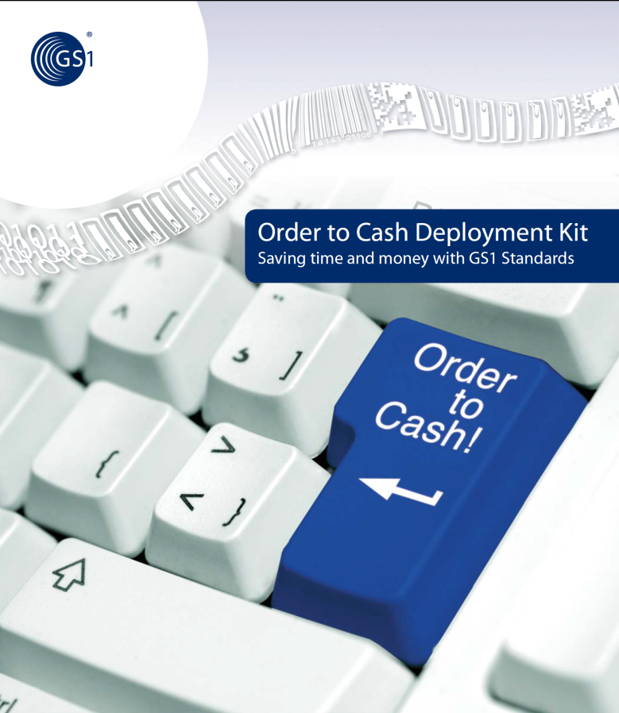
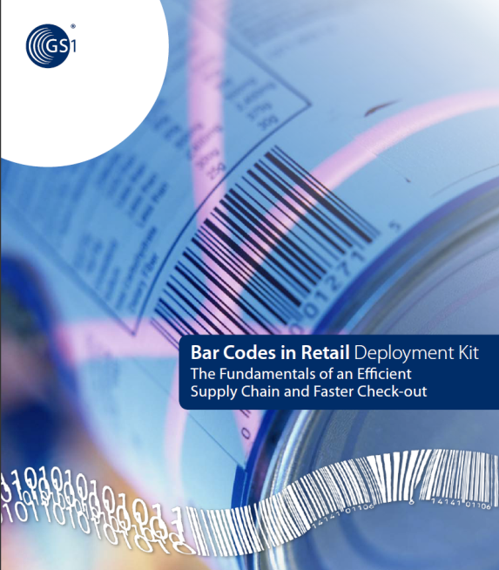




MO Deployment Kits
Order to Cash
Bar Codes in Retail
Solution Providers
Building partnerships to enable GS1 Standards Implementations
Food Traceability
Fresh Foods
Transport Management
Notes:
In 2012, 5 new deployment kits developped based on best practise from Mos
4 of them have immediate impact on RVC

Slide 5

Inflection point: B2C
B2C TSD project and pilot launched successfully
B2C TSD standard released by Dec 2012
Data Quality project repositioned for B2B2C

Slide 6



Cap Gemini-GS1-TCGF strategic research
Objective: Perform a strategic research study aimed at identifying requirements for supply chain standards and services in the future
Target: interview 25 C-level executives (CEOs or Chief Supply Chain Officers, CIOs, CMOs, etc.) of TCGF Board companies
Initial findings confirm Key projects GS1 is working on.
Released in October 2012
Presented to TCGF board and GS1 MB by Jose Lopez

Slide 7

Welcome Lynda
25 year veteran of PepsiCo
Expertise in Sales, Marketing, Operations, Quality, Innovation and Procurement
Define industry needs of RVC that can drive the development of GS1 standards, solutions & services
Establish key contacts with TCGF and their members
Build MO community for RVC
Lynda Costa
Retail Value Chain Vice President

Slide 8

“The flywheel is beginning to turn on RFID, and once it starts it will just turn faster and faster.” — Tom Cole, CAO, Macy’s Inc.

Slide 9
Apparel and EPCglobal
Acceleration of EPC adoption in Apparel in US and EU
Business case on Inventory Management Accuracy
Strong focus on Item-Level tagging at source
Apparel, Fashion and Footwear (AFF) Discussion Group in Dublin as launch for future Industry User Group
Stock-take (annual financial inventory) SBN drafted & MSWG launch
Positioning AutoID labs as GS1 ThinkTank
Growing interest in Visibility Applications (based on EPCIS) for Traceability and Anti-Counterfeiting, driven by Healthcare and Transport & Logistics

Slide 10

Healthcare

Slide 11

Key Achievements for the Healthcare community
The Level-Below Each progressing well
AIDC HC Standards Update: some topics important for UDI
Traceability kick-off in Dublin:
Pedigree Security, Choreography and Checking Services (SCCS) MSWG
GDSN: UDI Regulation released in EU and US (UDI Pilot with the FDA)
Public Policy: increasing importance and participation
Notes:
The Level-Below Each progressing well and very important to enable bedside scanning to prevent medication errors as well as for UDI where sometimes identification will be requested also on that level
AIDC HC Standards Update: some topics important for UDI Draft UDI regulation now released in US and Europe – here work is going regarding identification of kits and software and Direct Part Marking, but also the GTIN non re-use policy is worked here into the Gen Specs
Traceability kick-off in Dublin:
Pedigree Security, Choreography and Checking Services (SCCS) MSWG – important work to enable network centric ePedigree in the future, so traceability with the information hold in a network instead being passed on from one trading partner to the other and so accumulating
GDSN: UDI Regulation released in EU and US (UDI Pilot with the FDA) UDI regulation is about identification and marking, but requests from the manufacturer’s to deliver product information into a database, hold by regulatory bodies – this is THE opportunity for GDSN in Healthcare
Public Policy: increasing importance and participation The work in this group is getting more and more important – participation is constantly very high and the information the group is holding very much valued by all stakeholders, global members as well as MO’s.

Slide 12
McKinsey White Paper
McKinsey & Company has developed a Business Case for Global Standards in Healthcare
More than 80 healthcare industry leaders interviewed
Leverage White Paper in a global Marketing and Communications campaign
Launch at the Global HC Conference in Lisbon, 23 OCT
Promoted by McKinsey in Global Forum, FEB 2013

Slide 13

Transport & Logistics

Slide 14
T&L: What have we achieved so far?
Strategy approved
Transport messages ratified
Transport Management Deployment Kit including Implementation guideline delivered
GS1 T&L MO Interest Group strengthened
GS1 Id Keys in T&L position paper ready for GSMP review
Customs Engagement Starter Kit delivered
GS1 T&L Online containing engagement support tools for MOs launched
Marketing tools delivered

Slide 15

Transport & Logistics: what’s next?
Logistics Interoperability Model (LIM) Warehousing Message Standards
GS1/RFID in Rail
GS1 Cross Border eCom (WCO)
GS1 - WCO collaboration on Anti-Counterfeit tool (IPM)
GS1 eSeal

Slide 16


PARTICIPATION
70 participants from 24 companies & associations + 20 MOs
SPEAKERS
TCGF, WCO, Delhaize, DHL, DSV, Stena Line , Swedish Rail Administration, Marlo, SINTEF, Oracle, RedPrairie, TakeCargo, GS1 US, GS1 NL
TOPICS
Innovations in transport & warehousing
The Future Value Chain and key Transport & Logistics trends
Efficient shipping and receiving
Moving products across borders with greater security, visibility and efficiency

